Slide 1

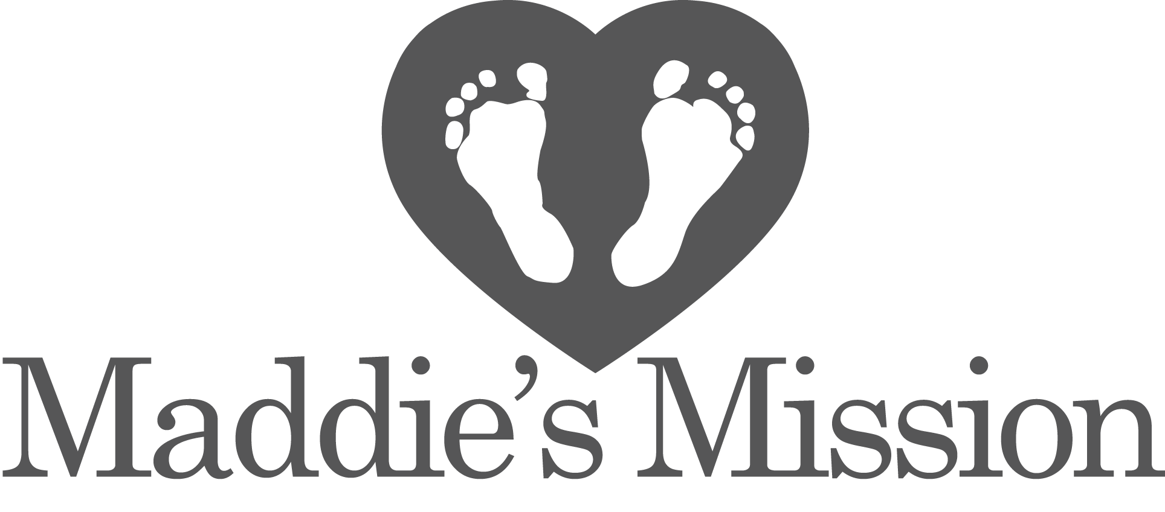

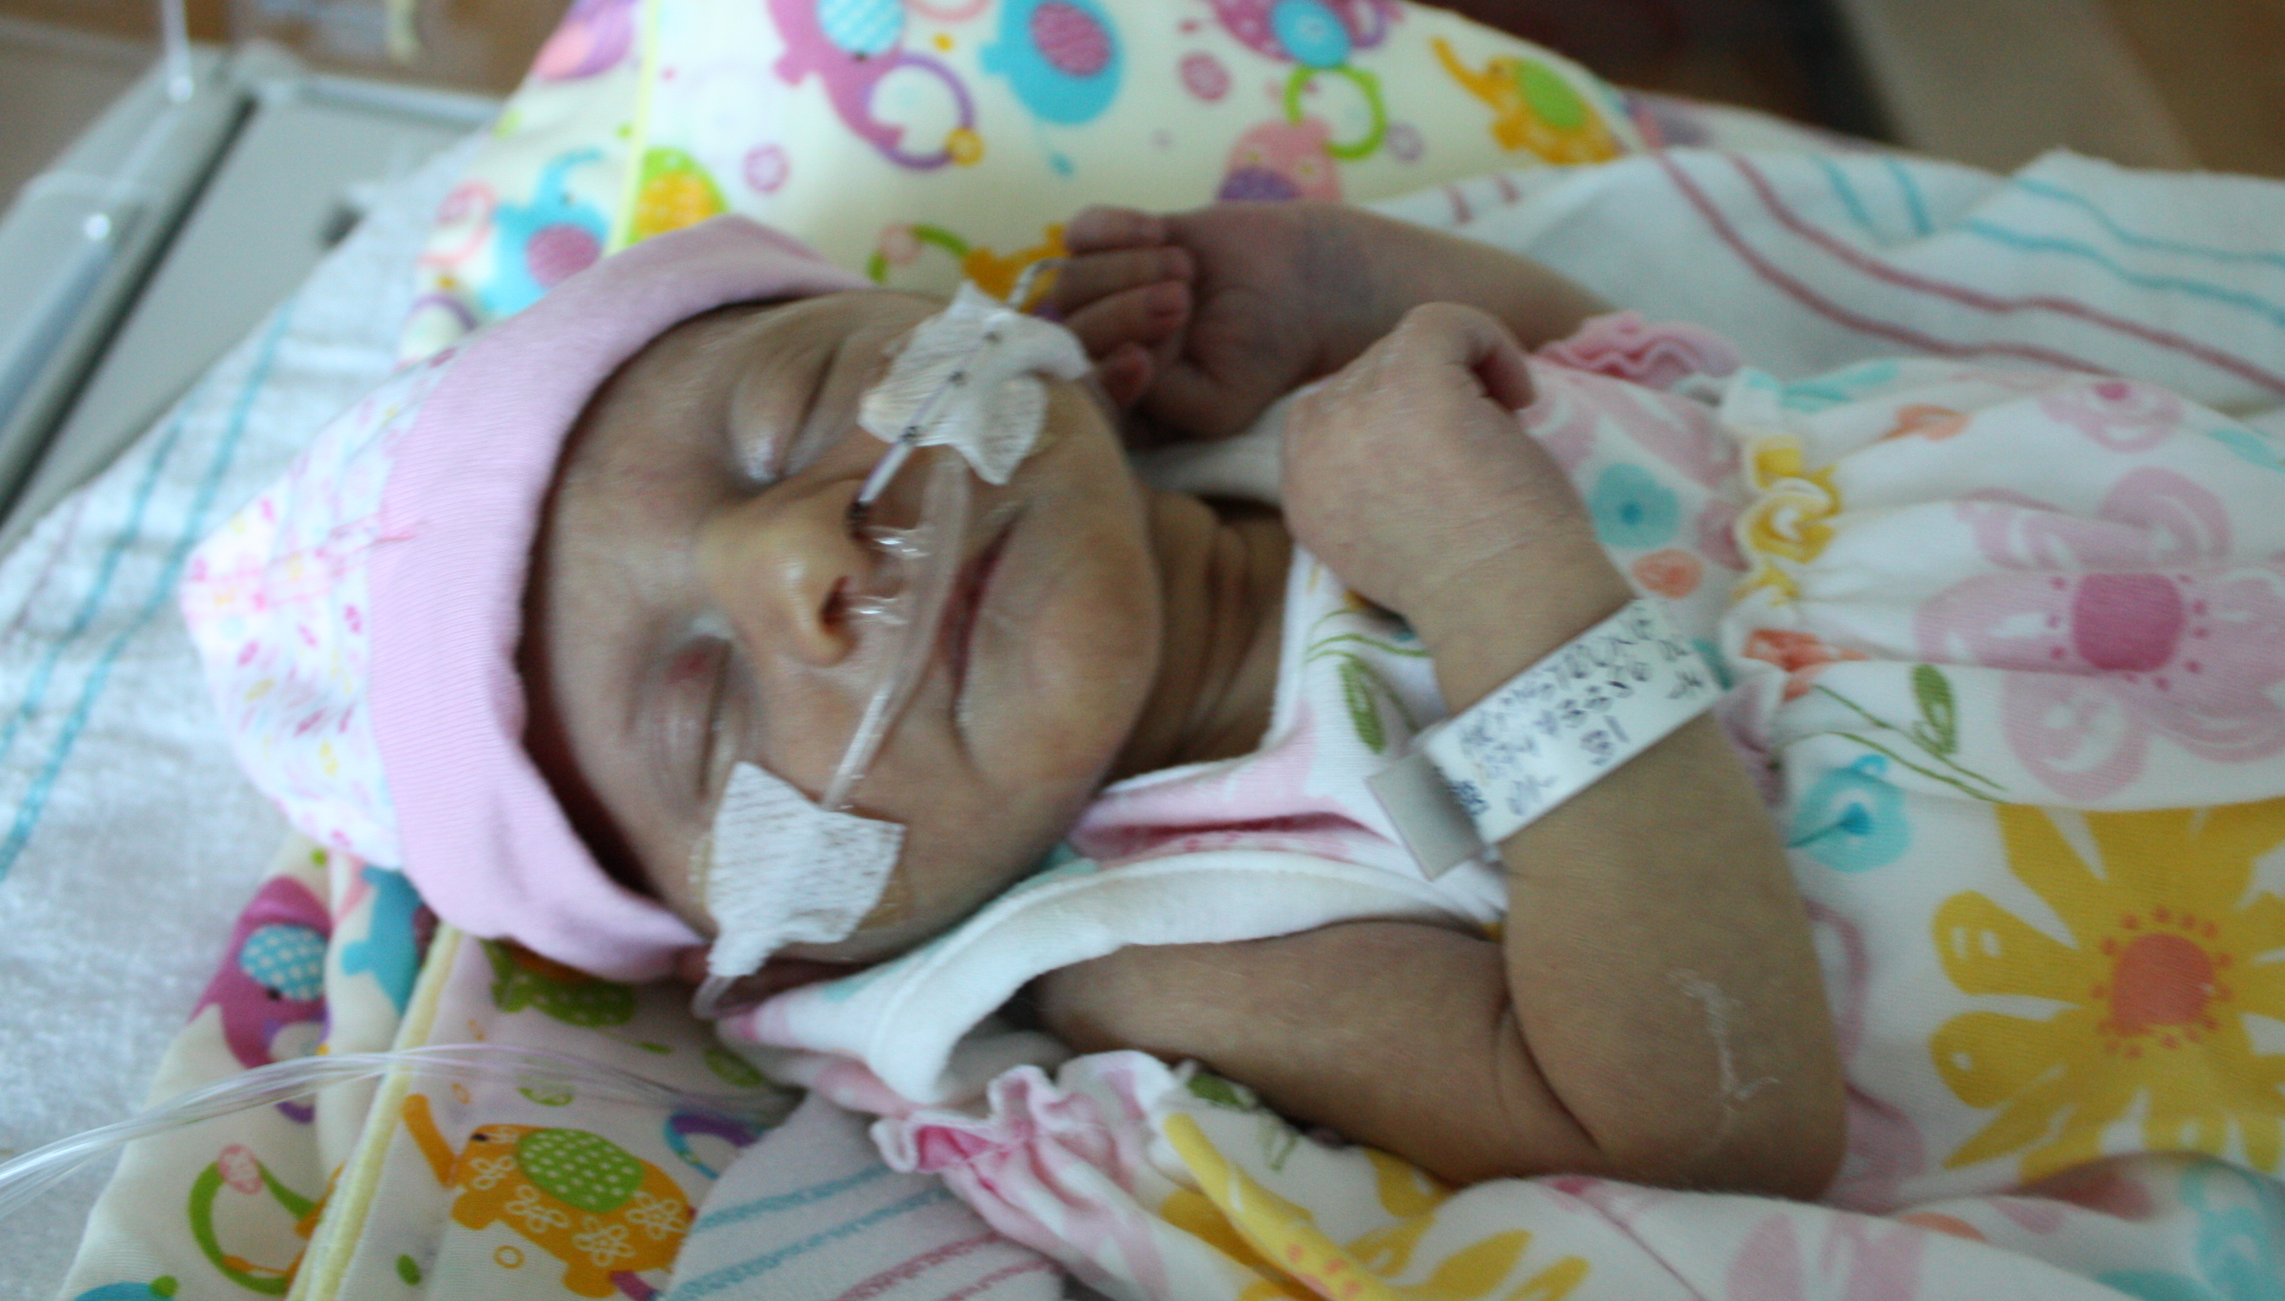
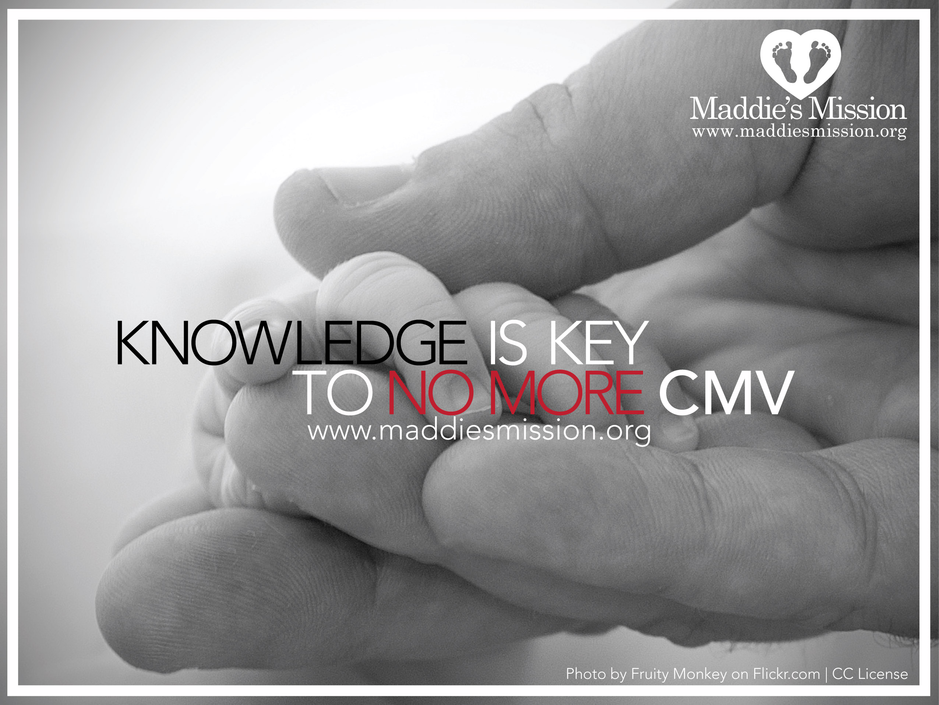
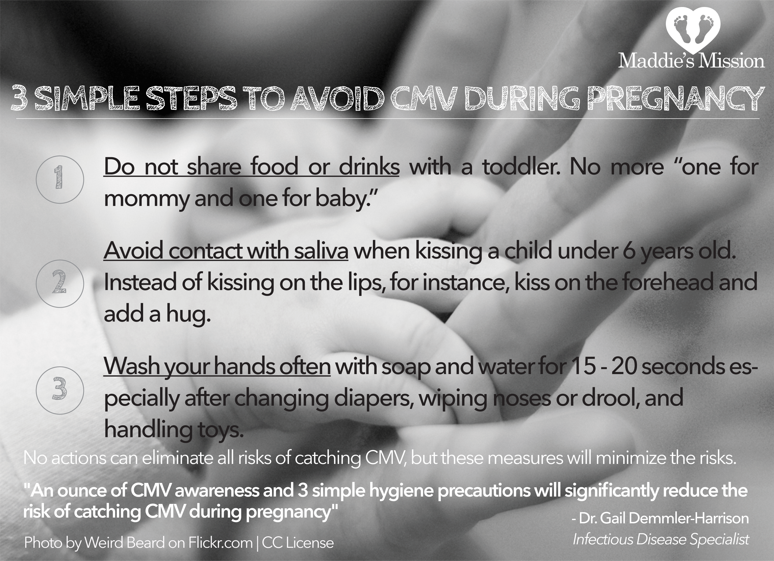
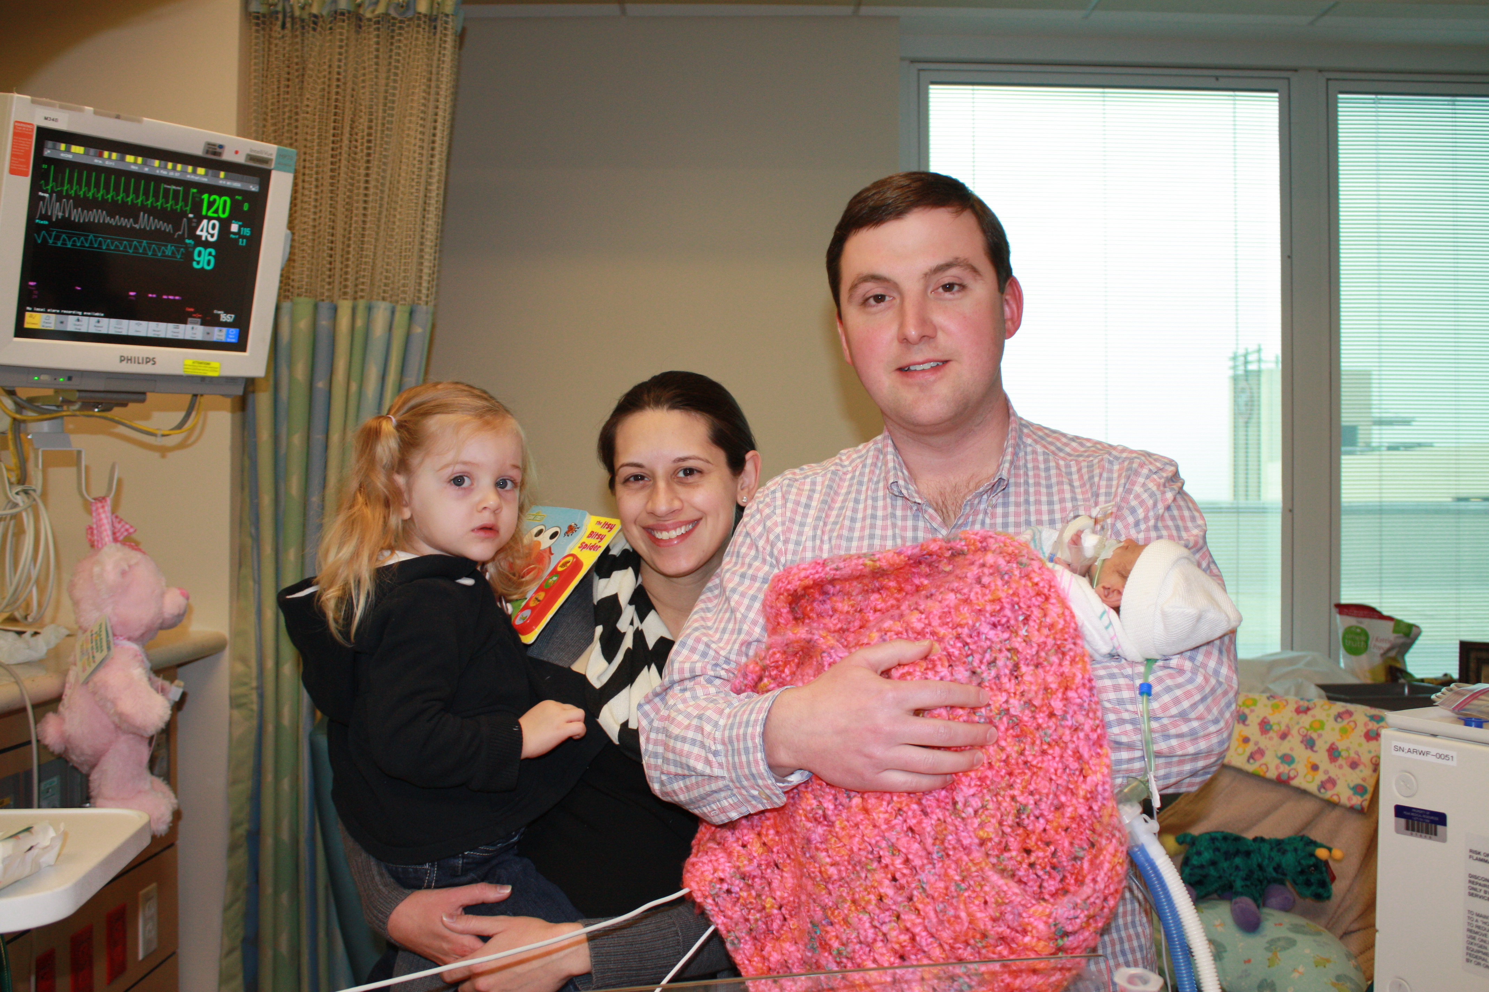
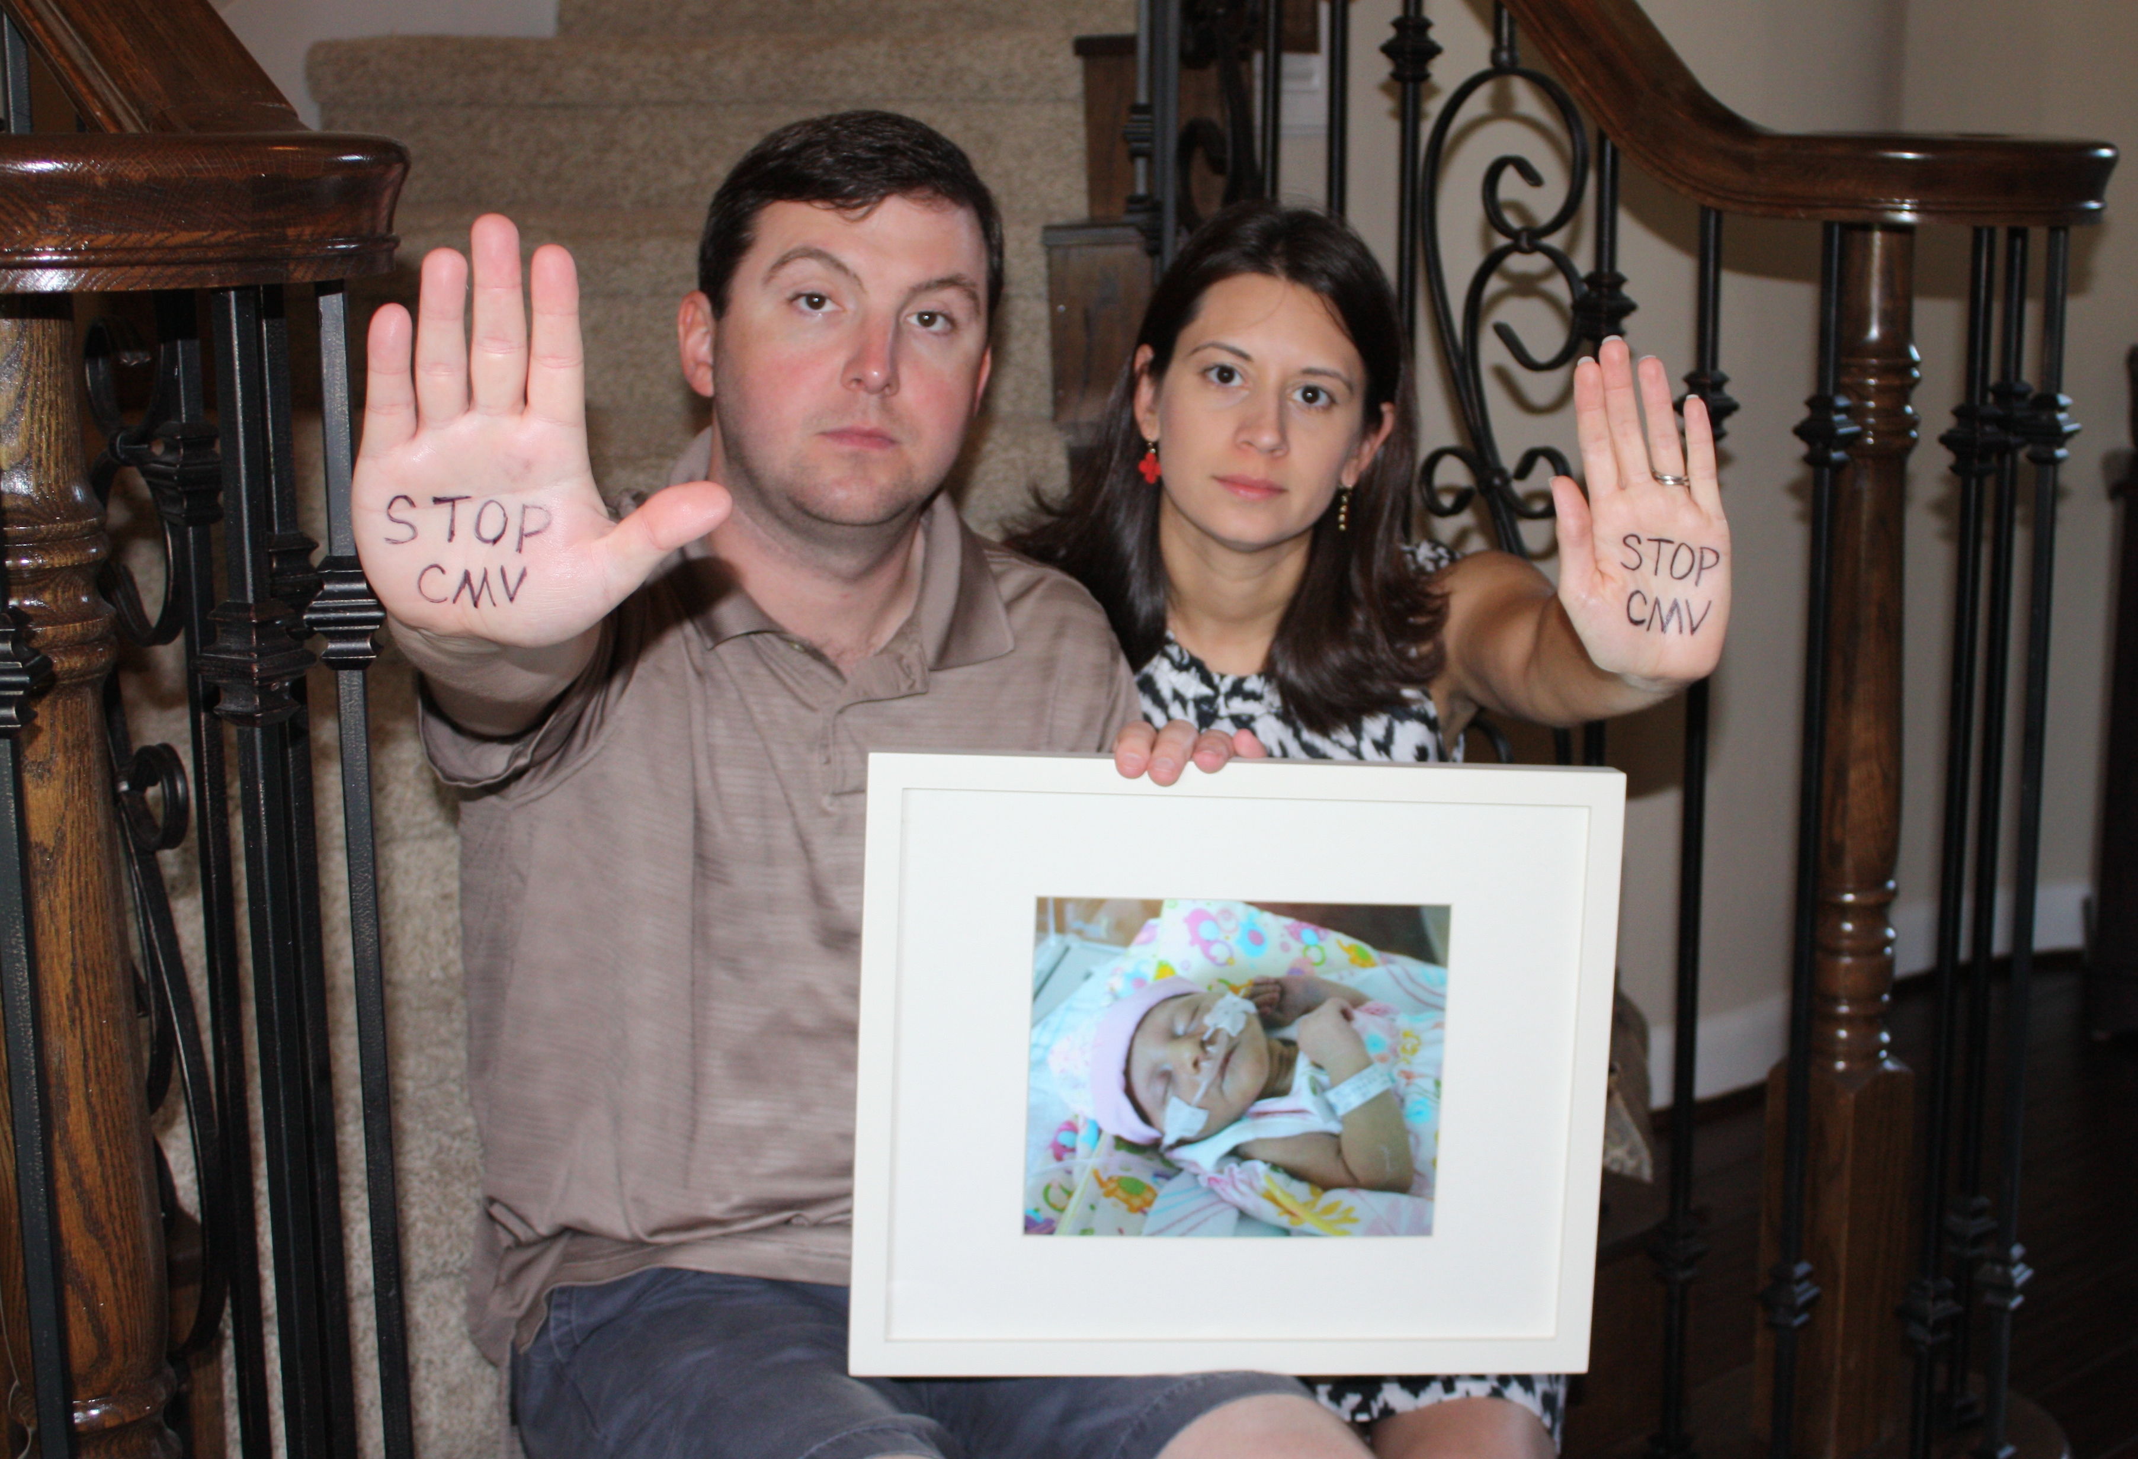
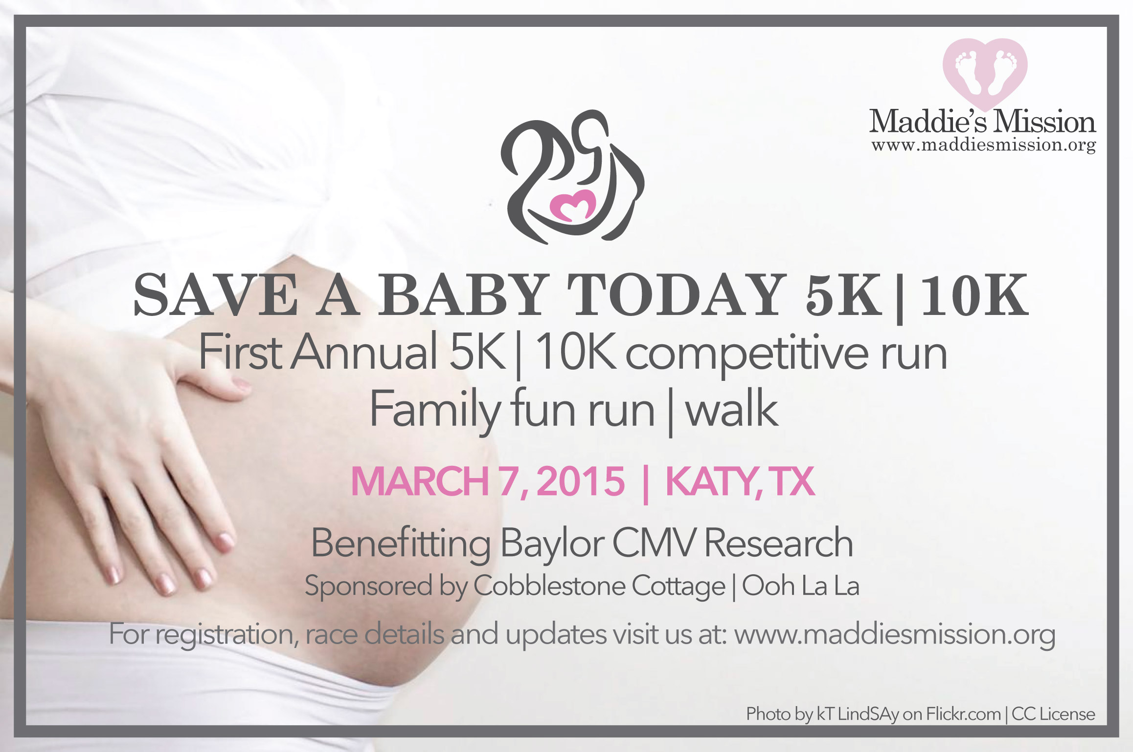
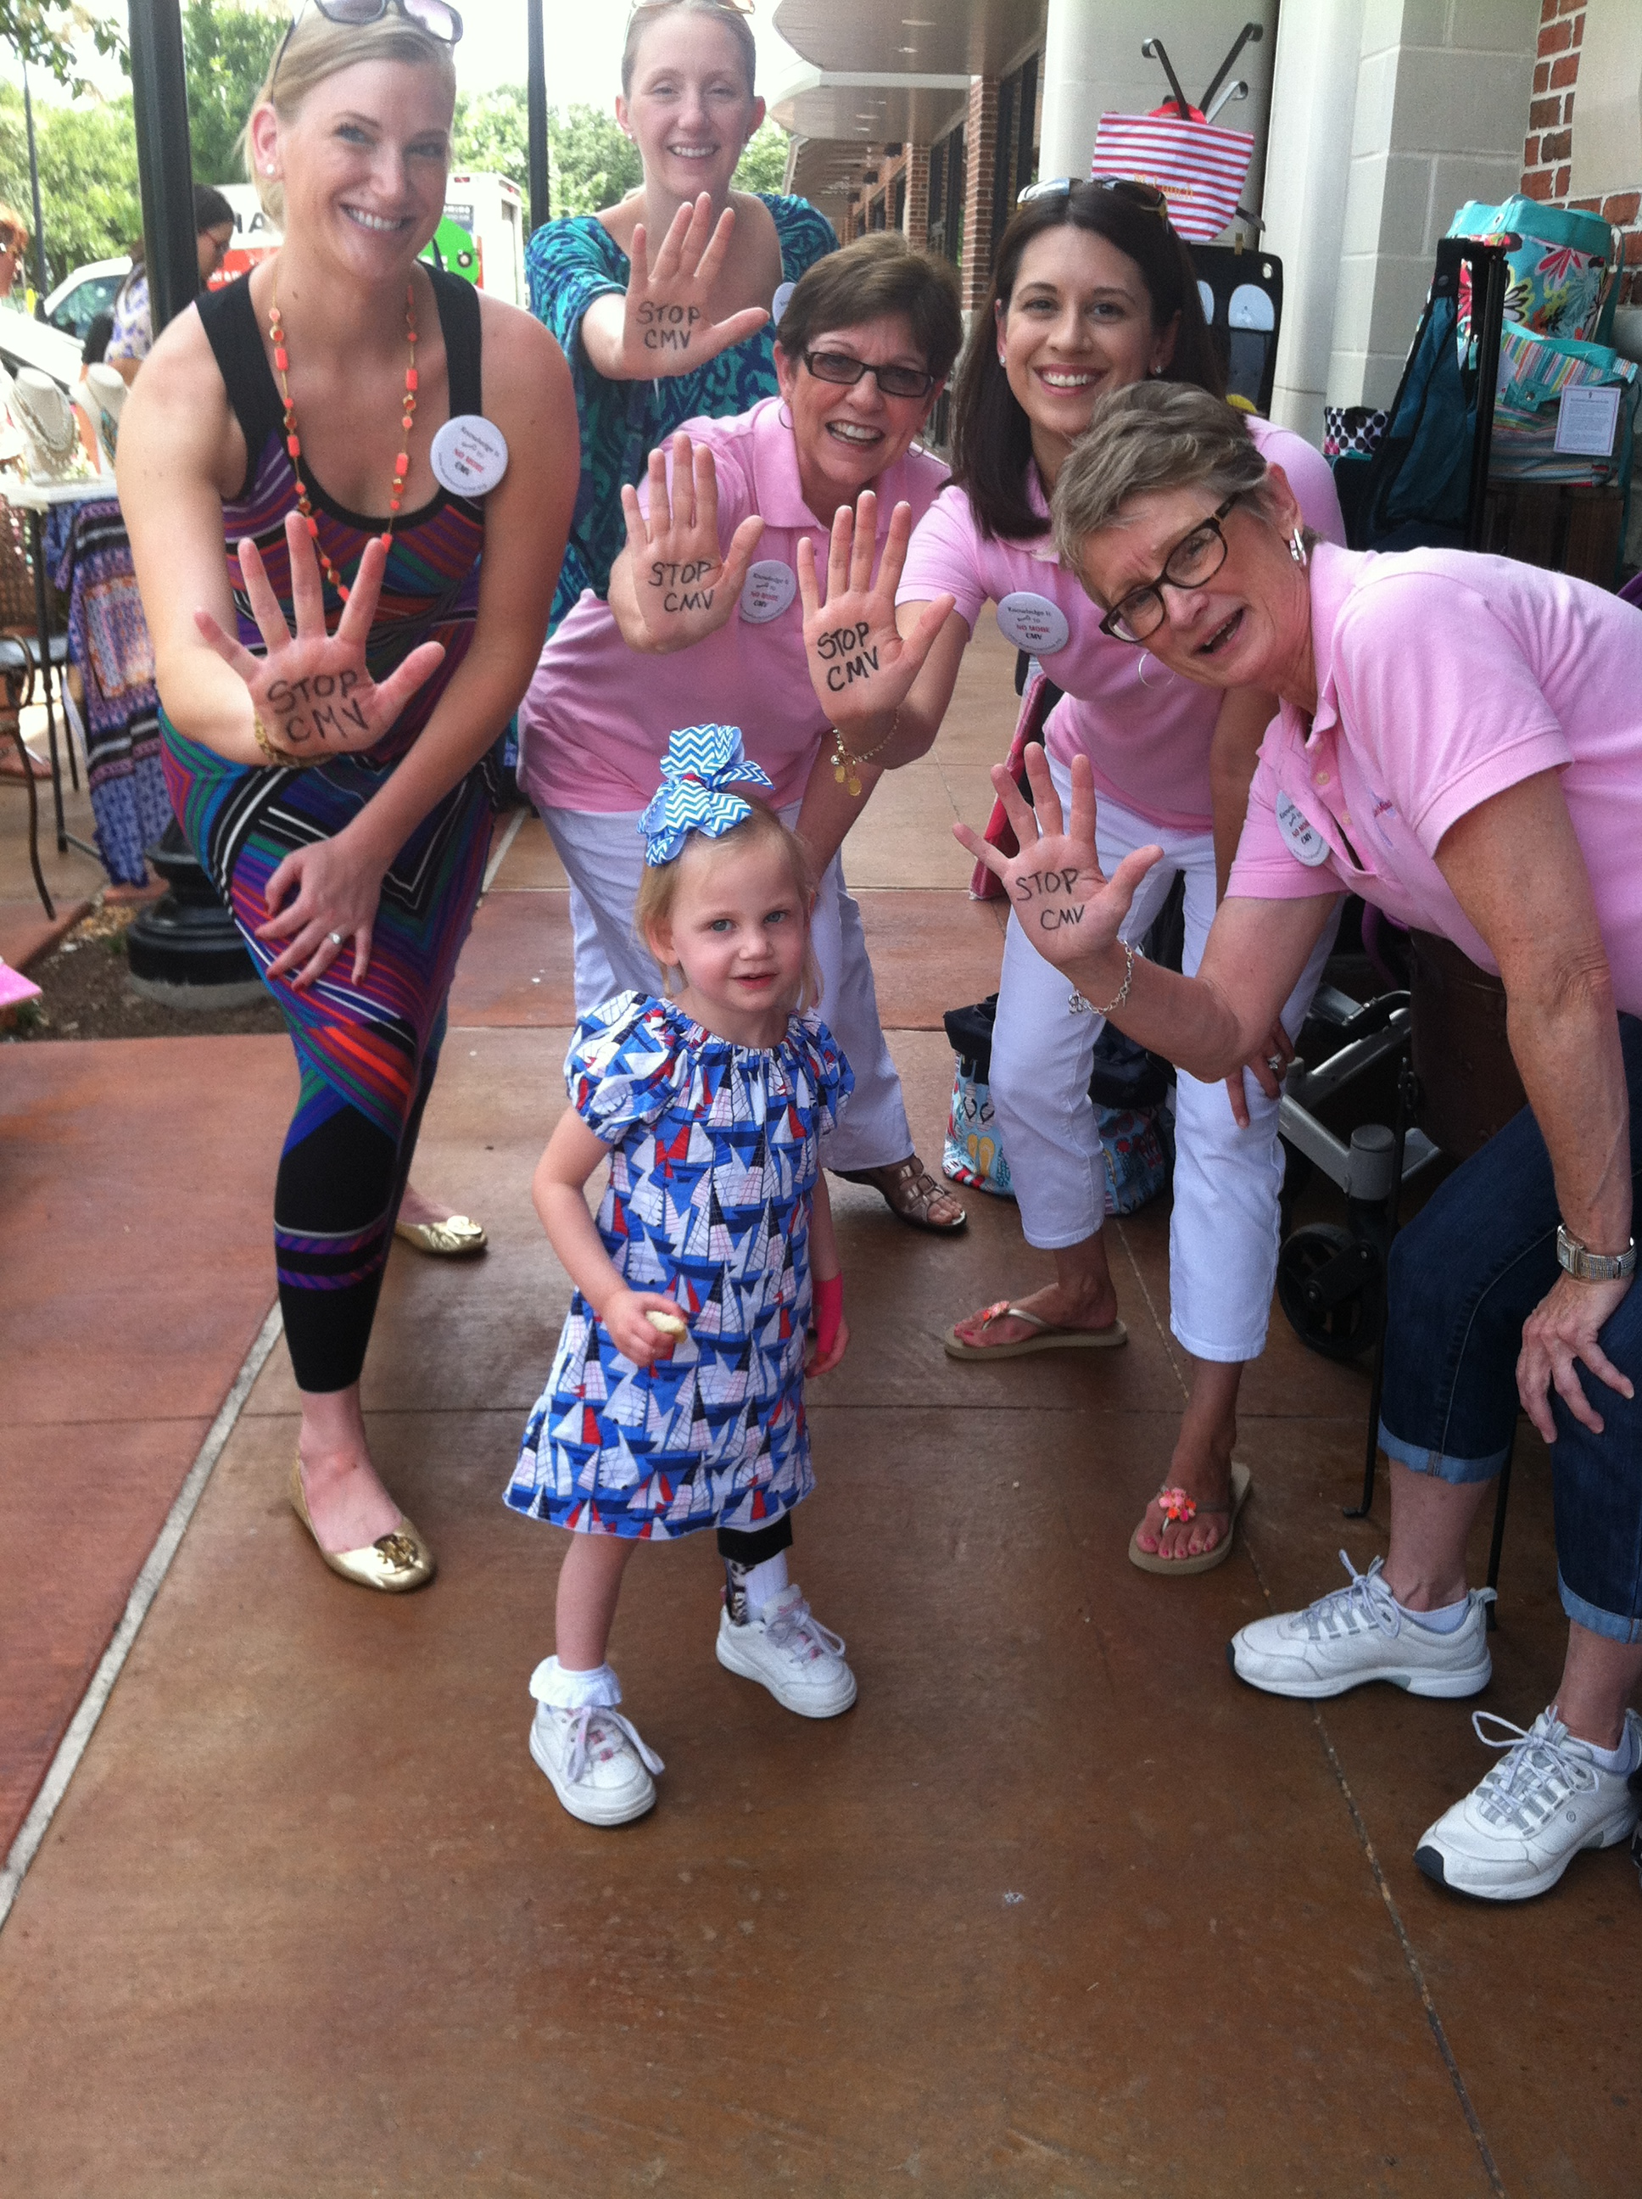
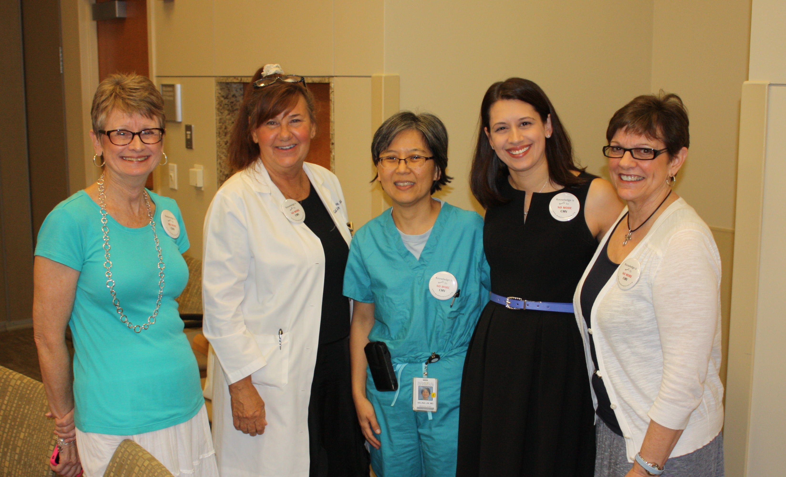
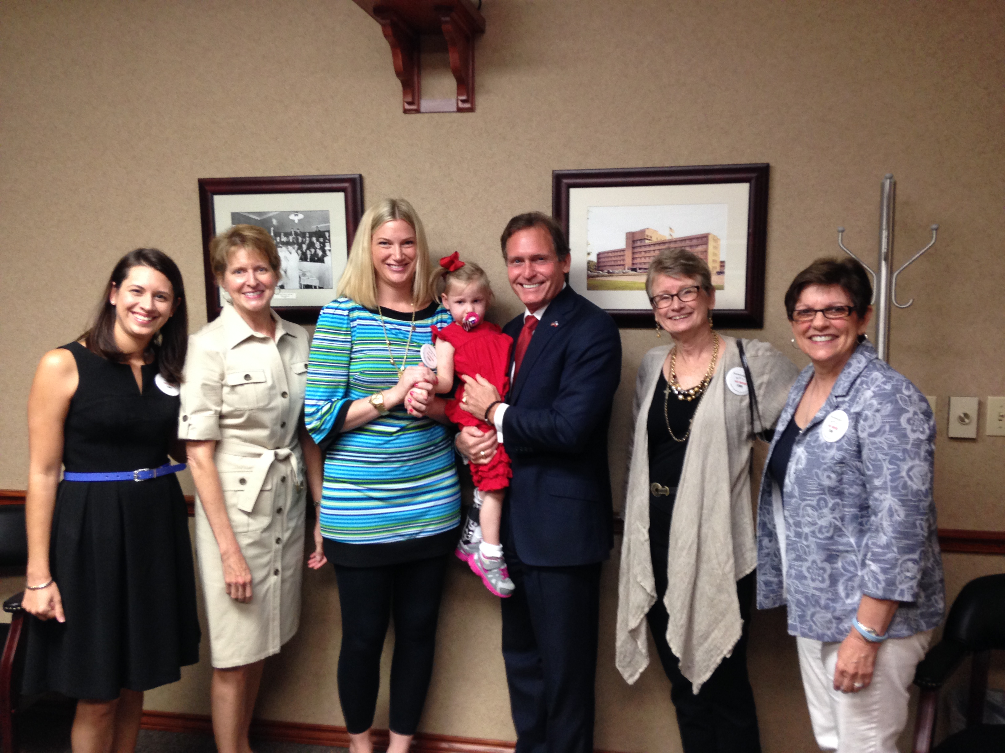
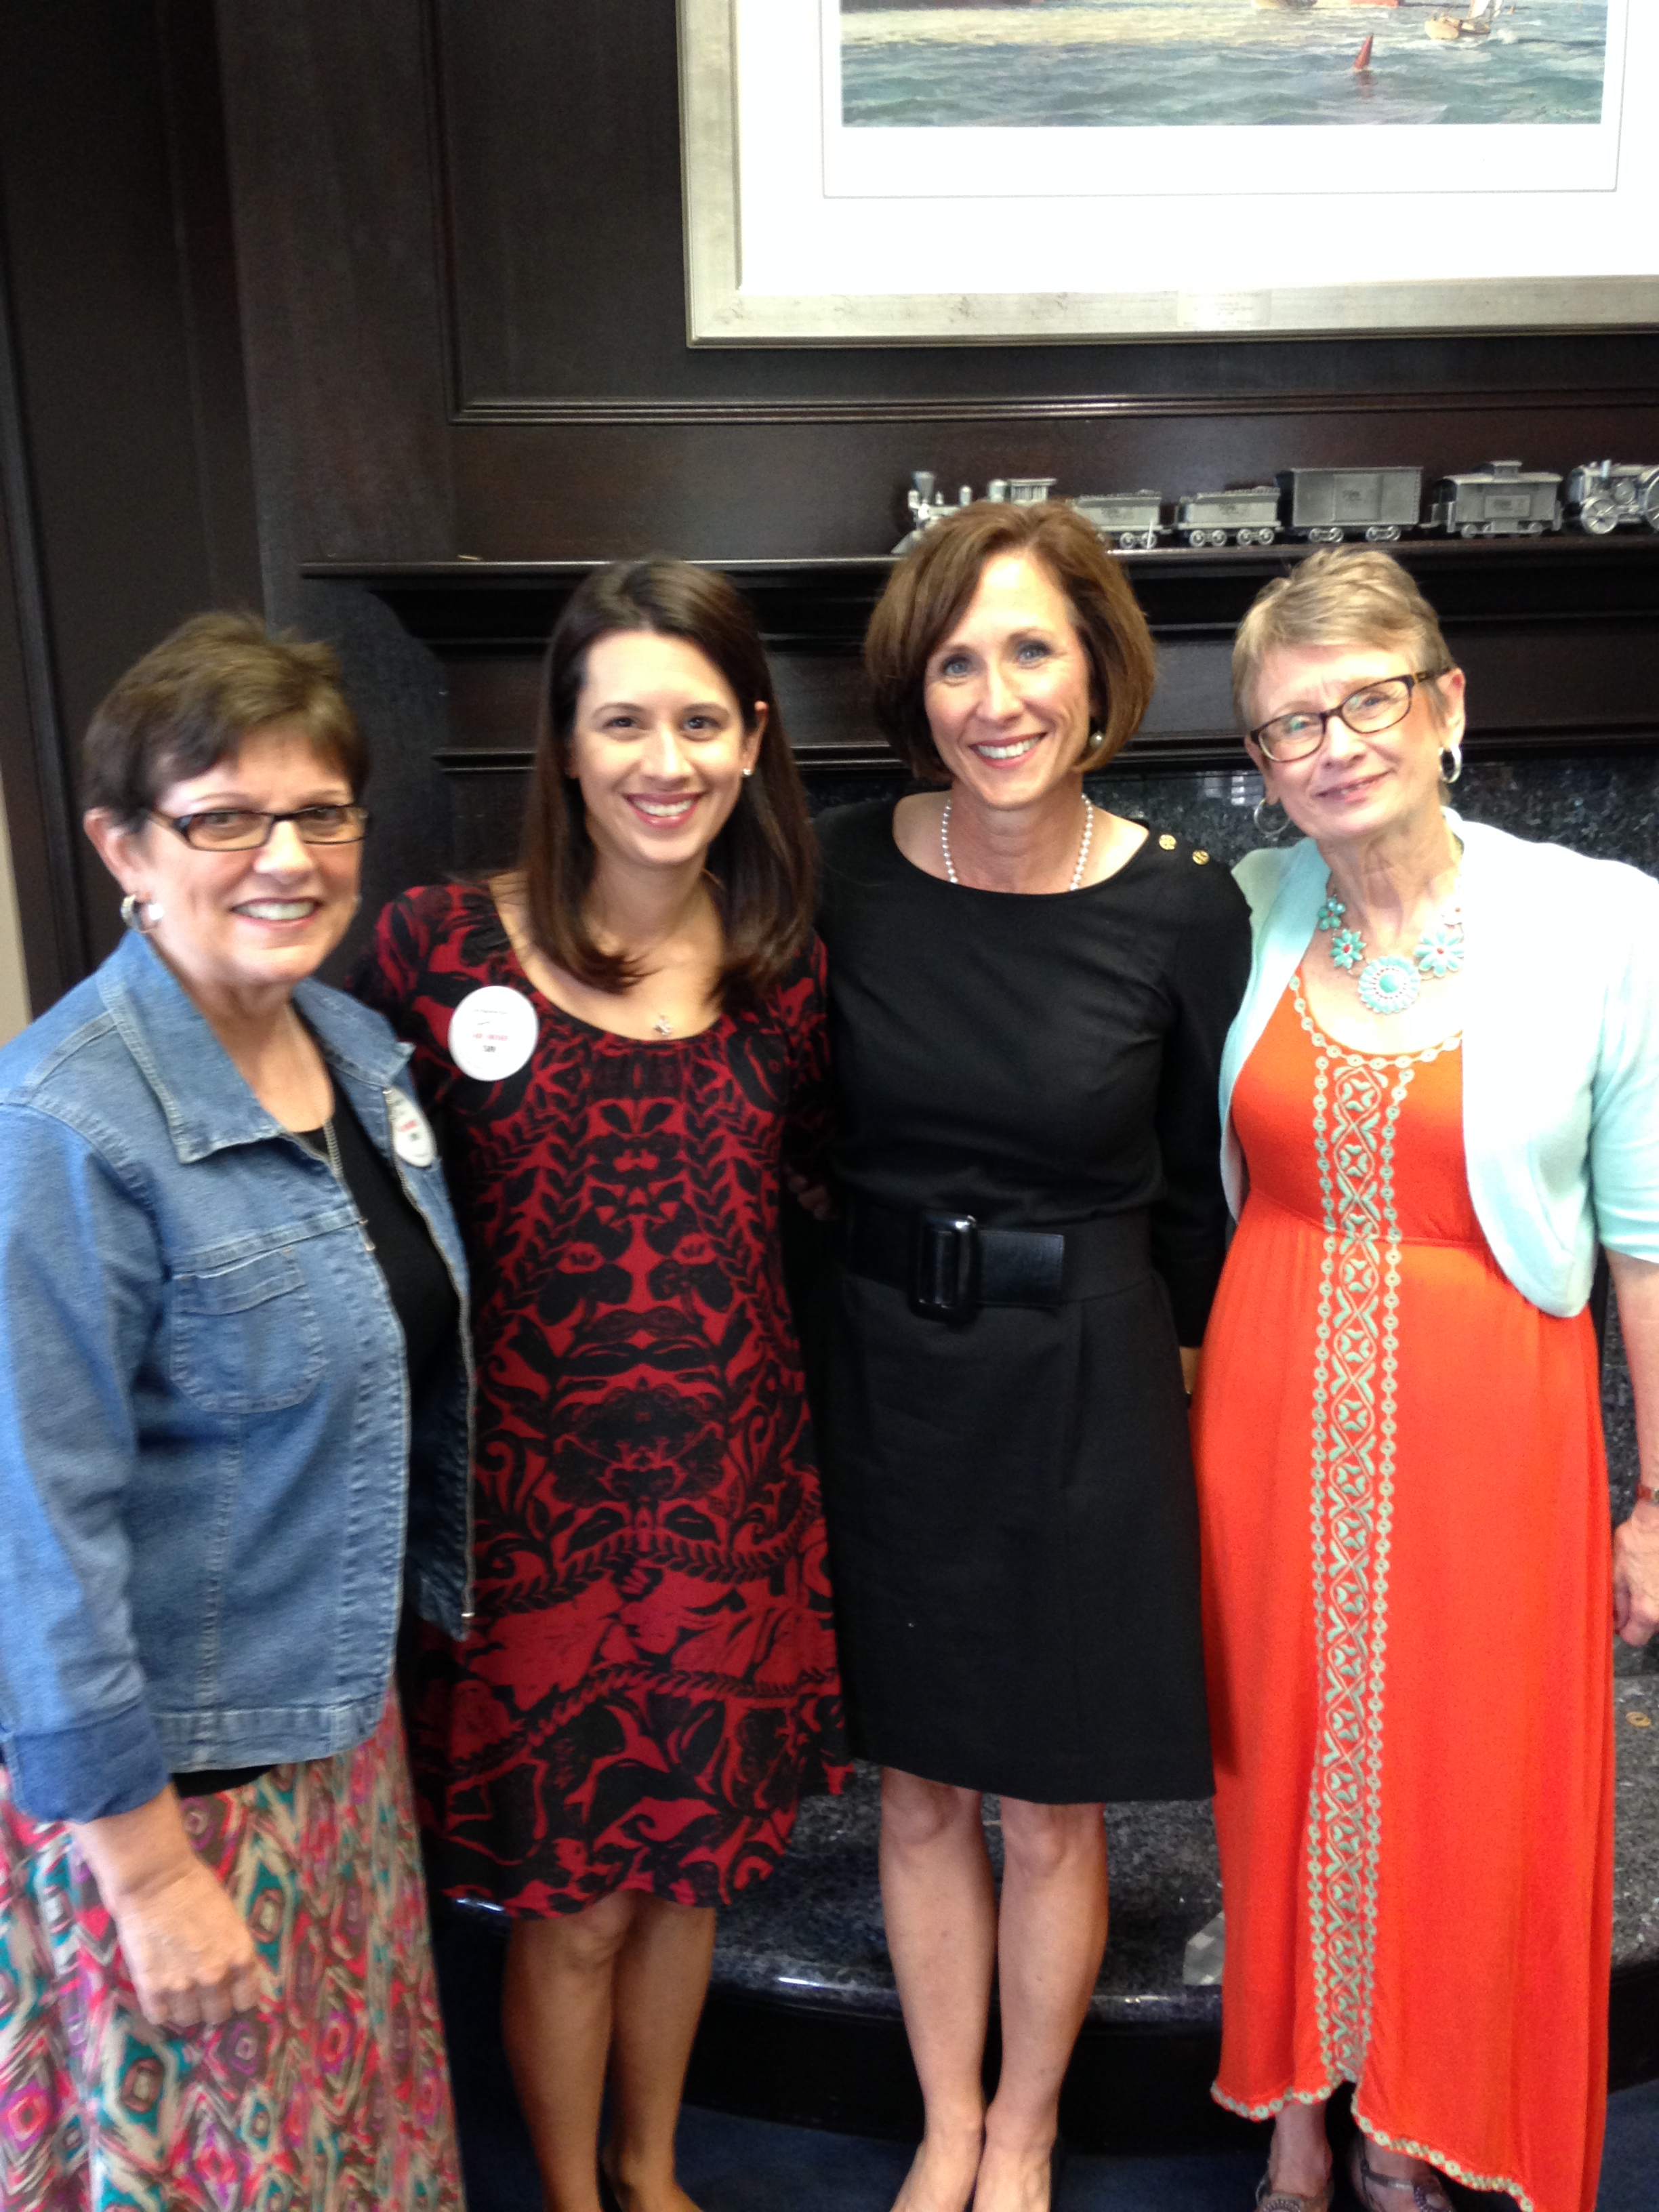
TURNING DESPAIR INTO ACTION:
A MOTHER’S MISSION TO RAISE CMV AWARENESS AFTER THE LOSS OF HER DAUGHTER
Farah Armstrong, Becky Ghazi, Ann Blalock
Background: Madeline’s CMV Story
Results
Madeline Leigh Armstrong was born in Katy, Texas on January 31, 2014. After a textbook pregnancy with normal ultrasounds and routine doctor visits, her parents were shocked to learn that
Educating Others
Raised $41,000 for Stop CMV.
Reached 575 individuals through social media.
Distributed ~ 1000 CMV awareness pamphlets and flyers to pregnant women and future parents.
Designed, assembled, and distributed 280 CMV awareness buttons for National Congenital CMV Awareness Month.
Educated 1050+ people through our June E-Newsletter.
Participated in a CMV presentation to the medical community at Memorial Hermann Katy Hospital.
Shared Maddie’s CMV Story in the June Issue of Katy Lifestyles and Homes Magazine which is mailed to ~ 40,000 homes in Katy, Texas.
Reached ~ 3,500 women through the CMV Awareness Series published on Houston Mom’s Blog.
Educated shoppers at a two-day event hosted by Cobblestone Cottage in Katy.
Maddie had contracted congenital CMV in utero. The Armstrongs had never heard of CMV until one hour after their daughter was born. Maddie was in the NICU for ten days while she went through numerous medical procedures and tests. Once her parents received the devastating news that she was terminal, they began making arrangements to bring her home on hospice care. Maddie passed away after two days at home. She was only 12 days old.
Methods: Grassroots CMV Awareness
A few weeks after Maddie passed away, her mission was born. Donations were raised for Stop CMV in memory of Maddie and the Armstrongs participated in local television and newspaper interviews to raise CMV awareness throughout Houston.
Developing a Nonprofit Organization
Received approved 501(c)(3) nonprofit organization status in July, 2014.
Collaborating with the March of Dimes Houston Chapter to start planning for future opportunities to work together.
Hosting our first annual fundraiser on March 7, 2015.
  Save A Baby Today 5k / 10k targets reaching a large group of participants in the Houston area.
  Our goals for the event are to increase awareness of congenital CMV and raise funds for Baylor College of Medicine CMV Research and Maddie’s Mission CMV Awareness efforts.
Maddie’s Mission, a grassroots organization in Katy, Texas was founded by Farah Armstrong, Becky Ghazi, and Ann Blalock in February, 2014. We strive to raise awareness about the potentially harmful effects of CMV during pregnancy and to educate families about prevention measures.
Maddie’s Mission has developed educational materials to distribute to daycares, preschools, obstetric and pediatric offices, moms’ groups, church nurseries, etc. We also launched a website and social media to extend the reach of CMV awareness online and implemented several awareness initiatives for National Congenital CMV Awareness Month.
Pursuing CMV Legislation in Texas
Working with two other CMV mothers and Dr. Gail Demmler-Harrison to develop a team to pursue CMV legislation in Texas.
Contacting Texas legislators through email letters and phone calls to share personal CMV experiences.
Meeting with Senators, Representatives, and their staffs to educate them about congenital CMV and to share our personal CMV stories to illustrate the need for legislation.
Developing a strategy for legislation based on feedback from legislators.
Continuing to develop and strengthen relationships with key legislators.
Maddie’s Mission strongly believes that CMV legislation is necessary to increase CMV awareness in Texas and to give every pregnant woman the opportunity to learn about CMV while it is possible to practice precautions. All too often, families learn about congenital CMV after their child is born affected by the virus.
CMV Public Health & Policy Conference Salt Lake City, Utah September 26 - 27, 2014

