Slide 1

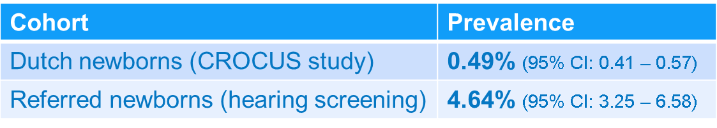
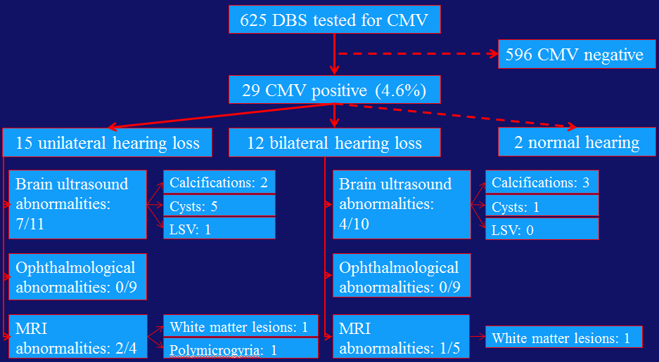


The need for screening newborns for congenital Cytomegalovirus referred in the Neonatal Hearing Screening Program
F.A.J. Schornagel ¹, M.J. Korndewal ^{1,} ⁴, W. Soede ³, L.G. Rusman ¹, J.J.C. de Vries ¹, A.C.M. Kroes ¹,
A.M. Oudesluys-Murphy ² and A.C.T.M. Vossen ¹
¹Dept of Medical Microbiology, ²Willem-Alexander Children and Youth Center, ³Dept of Otolaryngology, Leiden University Medical Center the Netherlands, ⁴Dept of Epidemiology and Surveillance, National Institute for Public Health and the Environment (RIVM) the Netherlands
Introduction
Congenital Cytomegalovirus (cCMV) infection is the most frequent cause of non-hereditary congenital hearing loss. In the Netherlands the birth prevalence of cCMV is 0.5%, yearly resulting in almost 1000 infected newborns [1]. Of these newborns, 17-20% will suffer from long term sequelae (hearing loss, cognitive deficit and motor deficit) [2]. Hearing loss is often the first indication of a cCMV infection in otherwise healthy infants.
Aim & Methods
Aim
Determine the prevalence of cCMV and describe the hearing loss and neurological and ophthalmological defects, in the group of referred newborns in the Neonatal Hearing Screening Program in the Netherlands.
Methods
Parents of newborns who failed the Neonatal Hearing Screening Program in the Netherlands are invited to participate in the CONCERT study. Dried blood spots are tested for CMV with PCR. Data shown are a subanalysis concerning the prevalence of cCMV in the dried blood spots tested up to and including August 2014.
CONCERT study
Congenital Cytomegalovirus: Efficacy of Antiviral Treatment in a non-Randomized Trial with Historical Control Group
Aim
Study the efficacy of valganciclovir in infants with congenital CMV (asymptomatic at birth) and sensorineural hearing loss.
Intervention
6 weeks valganciclovir 32 mg/kg daily dose; oral solution.
Monitoring during treatment
Infants will be monitored weekly for leucocyte count and at inclusion and after treatment for liver and kidney function. Blood, and urine on filter paper, will be sampled weekly at home during treatment and one week after treatment.
Time schedule
Inclusion ongoing, efficacy results expected 2017.
Results
Congenital CMV prevalence
10-fold higher CMV prevalence amongst referred newborns compared to birth prevalence.
Diagnostic imaging and ophthalmological outcome for cCMV infected newborns
Contact
Website: www.lumc.nl/concert
Email: f.a.j.schornagel@lumc.nl
a.vossen@lumc.nl
Conclusion
Amongst referred newborns in the NHS program the CMV prevalence is 10-fold higher. These referred newborns should be tested for CMV. The earlier infants with cCMV are diagnosed, the better their chances for appropriate medical treatment and audiological care.
References
[1] de Vries JJ, Korver AM, Verkerk PH, Rusman L, Claas EC, Loeber JG, et al. Congenital cytomegalovirus infection in the Netherlands: Birth prevalence and risk factors. J Med Virol 2011 Oct;83(10):1777-82.
[2] Dollard SC, Grosse SD, Ross DS. New estimates of the prevalence of neurological and sensory sequelae and mortality associated with congenital cytomegalovirus infection. Rev Med Virol 2007 Sep;17(5):355-63.

